Slide 1
Classes & Objects
Using Python

Slide 2
ASSESSMENTS
Quiz- 10%
Class Participation- 10%
Midterm Exam-30%
Final Exam-40%
Project Viva / Presentation-10%

Slide 3
Class / Lab Rules
Use of internet is not allowed unless explicitly allowed
Use of mobiles is not allowed unless explicitly allowed
No late comings (more than 10 minutes) or early outs
Discipline should be maintained in teacher’s presence

Slide 4
In case of breach of lab rules vote for marks deduction or samosa party?

Slide 5
How to get good grades?
By putting earnest effort-which brings fruitful results
By having 75% attendance
By submitting work on time
By adhering to lab and class rules

Slide 6
Procedural Programming
Procedural programming simply contains a series of computational steps, these steps instruct the computer on how to solve a task in logical steps.
A procedural program is typically a list of instructions that execute one after the other starting from the top of the line.
Procedural programming is best for simple programs.

Slide 7
Procedural Programming
Make a Sum function that receives a list of integers as an argument and returns the sum of integer values stored in a list. Print the returned total sum at the end.

Slide 8
Procedural Programming Example
def Sum(sample_list):
total = 0
for x in sample_list:
total += x
return total
list1 = [10, 200, 50, 70]
list2 = [3, 26, 33, 13]
print(Sum(list1))
print(Sum(list2))

Slide 9
Advantages of Procedural Programming
Best for general-purpose programming.
Reusability of the code.
It is easy to trace the flow of the program.

Slide 10
Disadvantages of Procedural Programming
The data is exposed (security issues).
Difficult to solve real-world problems.

Slide 11
Object Oriented Programming
Object-Oriented Programming are built around objects.
Object-oriented programming (OOP) is a computer programming model that organizes software design around data, or objects, rather than functions and logic.
An object can be defined as a data field that has unique attributes and behavior.

Slide 12
Object as Real-World Entity
An object has two characteristics:-
attributes
behaviors
For example, an object could represent an employee with attributes such as name, title, experience, etc., with behaviors like working, on-leave, underperformed, etc.,

Slide 13
Can you think of objects in real-world? Give Examples one by one

Slide 14
Advantages of Object Oriented Programming
Object-oriented programming enables you to develop large, modular programs that can instantly expand over time.
Object-oriented programs hide the implementation from the end-user.
It supports collaborative development, where projects are divided into groups.
OOP include code reusability, scalability and efficiency.

Slide 15
Class
A class is considered as a blueprint of objects.
Classes can be viewed as factories or templates for generating new object instances.
Each object instance takes on the properties of the class from which it was created.

Slide 16
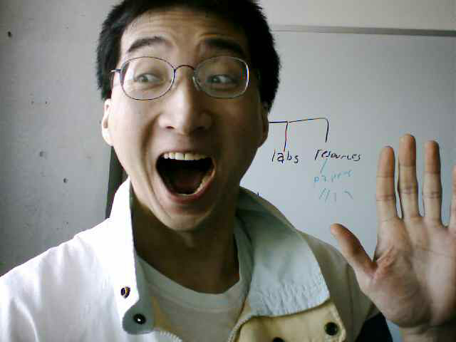
Classes Have Attributes
But Also Behaviors
ATTRIBUTES
Name:
Phone:
Email:
Purchases:
BEHAVIORS
Open account
Buy investments
Sell investments
Close account
Image of James curtesy of James Tam

Slide 17
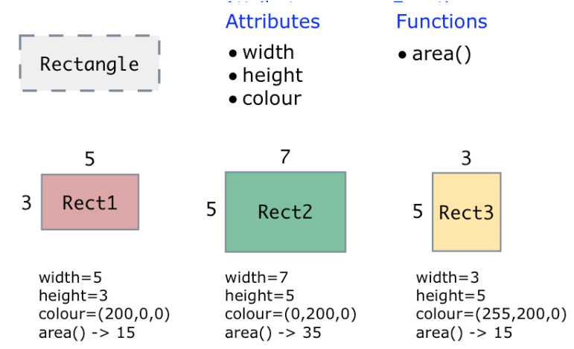
Objects as Instances of Class

Slide 18
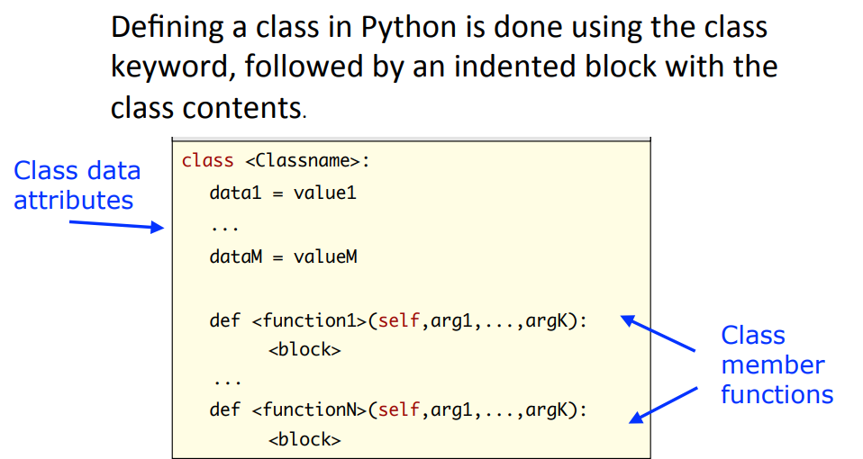
Class Creation

Slide 19
Defining Class Methods
Format:
class <classname>:
def <method name> (self, <other parameters>):
<method body>
Example:
class Person:
name = "I have no name :("
def sayName (self):
print ("My name is...", self.name)
Unlike functions, every method of a class must have the ‘self’ parameter (more on this later)
When the attributes are accessed inside the methods of a class they MUST be preceded by the suffix “.self”

Slide 20
Class Example
# create a class
class Room:
length = 0.0
breadth = 0.0
# method to calculate area
def calculate_area(self):
print("Area of Room =", self.length * self.breadth)

Slide 21
Creating Objects
# create object of Room class
study_room = Room()
# assign values to all the attributes
study_room.length = 42.5
study_room.breadth = 30.8
# access method inside class
study_room.calculate_area()

Slide 22
Complete Code
# create a class
class Room:
length = 0.0
breadth = 0.0
# method to calculate area
def calculate_area(self):
print("Area of Room =", self.length * self.breadth)
# create object of Room class
study_room = Room()
# assign values to all the attributes
study_room.length = 42.5
study_room.breadth = 30.8
# access method inside class
study_room.calculate_area()

Slide 23
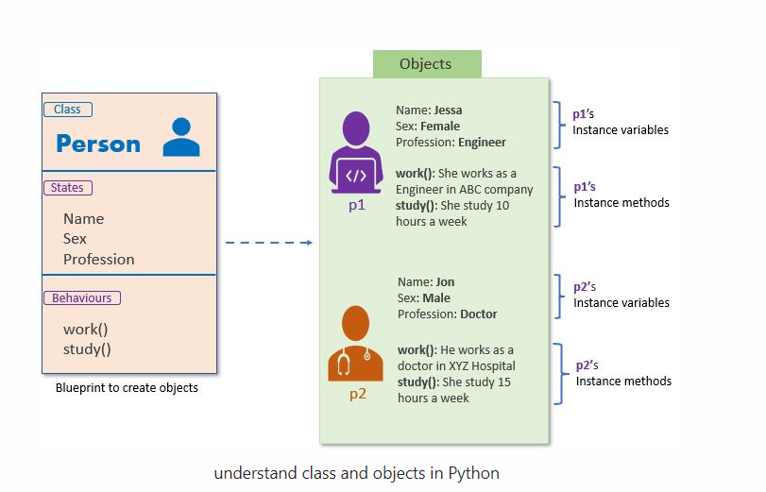
Class & Object

Slide 24
Class Example
Class: Person
Attributes / State: Name, Sex, Profession
Functions / Behavior: Working, Study

Slide 25
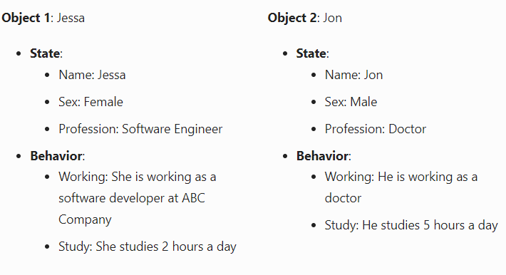
Objects of a class

Slide 26
Code the person class on the pattern of room class discussed previously

